Slide 1
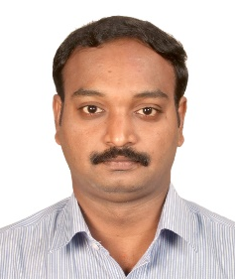
MANIVASAGAN NAMASIVAYAM
Informatica ETL Lead
Manivasagan Namasivayam
Around 15+ years of IT experience in Analysis, Design, Development and Deployment of technical solutions to business requirements.
2 years onsite work experience in US mainly Atlanta and Virginia
Extensively worked on Data Warehouse Full Life Cycle Projects for Health Care, Financial, Retail and Media industries.
Strong Data Warehousing ETL experience using Informatica Power Center 10.1,9.6.1/9.0.1/8.6 (Workflow Manager, Workflow Monitor, Source Analyzer, Warehouse Designer, Transformation Developer, Mapping Designer, Informatica Server, Repository Manager)
Experience in all the phases of ETL such as Extraction, Cleaning, Transformation and Loading using Informatica.
Extensive experience and exposure on several areas of the data warehousing and Business including requirements gathering, data warehouse architecture design, development, quality planning & assurance, data analysis and implementation.
Excellent understanding of the System Development Life Cycle. Involved in analysis, design, development, testing, implementation, and maintenance of various applications.
Extracted data from various sources ranging from various RDBMS like Oracle, Teradata, MS SQL Server, DB2 and Flat Files to load data into data marts and data warehouse.
Excellent working knowledge of Shell Scripting and job scheduling on platforms like UNIX.
Able to interact effectively with other members of the Business, Quality Assurance, Users and other teams involved with the System Development Life cycle.
Excellent analytical, functional, design and development skills with excellent communication skills
Ability to interact with the executives and perform independently as well as team environments.
Excellent working knowledge of Shell Scripting and job scheduling on platforms like UNIX.
Initiated scrum calls daily at Offshore and Leaded the conference call
Prepared and shared Deployment documents before monthly Sprint delivery
Mentored junior team members and provided necessary support to team members
Bangalore
Indian
Hindi, English, Tamil
ETL Lead
15 Years of experience in IT industry as Tech lead, ETL lead and Datawarehouse projects lead
8 years experience in Informatica ETL development
Sector Experience:
Industries: Healthcare, Banking , Media.
Technical Skill set:
Informatica, Oracle, SQL Server, Pentaho
MCA - Bharathiyar University
MPhil - Alagappa University

